Slide 1

ARCSE Survey Results
Frank Clearfield, retired NRCS employee January, 2024

Slide 2
Methods
Developed this survey with support of the ARCSE president and ARCSE board
Jerry Bernard distributed the survey link to the newsletter list on December 4, 2023, with email reminders on December 12 and December 18, 2023. The survey closed on December 20, 2023
This was a short survey (4 minutes or less) with 4 different types of questions: forced choice, select all that apply, rating questions, and open ended

Slide 3
Sample
747 emails were sent to the ARCSE membership, with 242 returned surveys for a 32% response rate
Based on past NRCS and Conservation District staff surveys, we projected the return rate would be a little higher
Age and health of the membership likely reduced the number of survey returns

Slide 4
Purposes
Explore interest of ARCSE members to mentor new NRCS employees. This request is based on a Memorandum of Understanding between NRCS and ARCSE that was signed 5/18/23
Explore interest of ARCSE members to work as Earth Team volunteers
Explore interest of ARCSE members to work in the ACES program
Rate ARCSE communications methods to Membership

Slide 5
Results - Programs

Slide 6
Are you interested in participating in:
N = 242

Slide 7
Respondents selection of activity(ies)
60 want to be mentors, earth team volunteers, and/or ACES employees
  41 want to be mentors
  28 want to participate with the earth team
  27 want to participate with ACES
    25 want to participate in more than one program
26 states represented
156 (64%) had no interest in any program

Slide 8
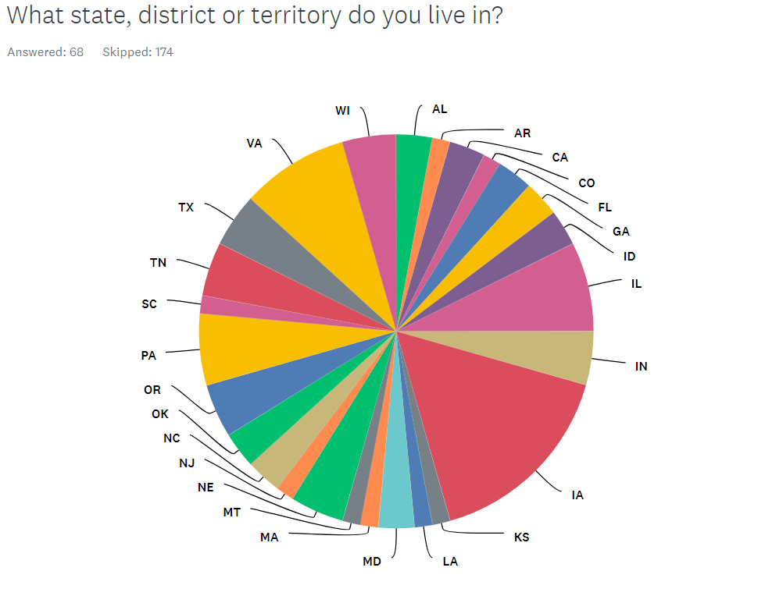

Slide 9
Top selections of skills (n=66)
45% Soil conservation
37% Conservation planning
33% Leadership
29% Engineering
29% Watershed planning
27% Soils
26% People skills
23% Supervisory skills
23% Farming and/or ranching experience

Slide 10
Why they don’t want to volunteer
Age
Lack of Time
Personal health issues
Serve as a care giver
Busy with Church activities
Skills have not kept up
Agency is much different

Slide 11
Results - Communications

Slide 12
Rating ARCSE Communications methods (1-5 scale)
1= excellent, 2= good, 3= average, 4= poor, 5 = very poor
Lower the “mean” the more positive the rating

Slide 13
Non-responses of communications question
Of the 242 who responded to the survey, approximately 175 rated the communications methods
A majority of those know about the newsletter and the website and rated them positively. Only 5% selected DN/NA (don’t know/not applicable) for the newsletter, and 39% selected DN/NA for the website
Respondents generally rated social media, state ARCSE meetings, and SWCS/ARCSE meetings less positively and a large percentage selected the DK/NA response
  Social Media – 66%
  State ARCSE Mtg – 62%
  SWCS/ARCSE Mtg – 59%

Slide 14
Communications summary
With this current group of survey respondents, the newsletter is highly supported, followed by the website, and a number of respondents wrote that they like receiving emails from ARCSE
National and state meetings are a traditional form of communications that have are positively supported, but only by a select few
Social media is not a communication method that many in this current group of retirees are familiar with, but it should continue to be utilized as the next generation of retirees will likely make more use of social media

Slide 15
Summary, actions, and recommendations
This survey identified those retirees interested in mentoring, earth team and/or ACES and a spread sheet with their skills and contact information was constructed
To protect confidentiality, the list should be sent to NRCS and ARCSE representatives responsible for their state. The ARCSE state representative can serve as a conduit between their state NRCS and the retiree
ARCSE staff need to follow up with those retirees who volunteered to ensure that they have been contacted and this process is successful
Even though 24 states and US territories did not have anyone volunteer through the survey, ARCSE members may still be interested in volunteering and retirees in the state may not be members of ARSCE. Follow through measures by NRCS and ARCSE need to be developed
ARCSE should continue all forms of communications with retirees and use hyperlinks in the newsletter to link to other communication methods to elaborate on topics of interest to the conservation community

Slide 16
Summary, actions, and recommendations (continued)
Only approximately 25% of retirees are ARCSE members; many retirees were not given the opportunity to volunteer through this survey
  Ask states and State Conservationists to get a full list of retirees in their states (if available)
  Develop a (similar) short survey to find out if any of those retirees want to volunteer
    For example, 3 questions – willingness to volunteer, skills/expertise, contact information
Many ARCSE retirees gave age as a reason for not volunteering
  Work with NRCS State Conservationists to acquire information about staff who are soon to retire and ask them about volunteering just before or after they retire

Slide 17
Questions
Contact information: frank.clearfield@gmail.com
617-955-6093

