Slide 1
Iowa’s Agriculture & Conservation History
ARCSE at SWCS National Meeting
August 7th, 2023
Notes:
Iowa’s Changing Agriculture &

Slide 2
Lyle Asell
Kevin Kuhn
Retired NRCS Assistant State Conservationist
Retired (Interim) IDNR Director
NRCS Resource Conservationist
kevin.kuhn@usda.gov

Slide 3
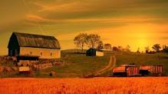
A Look Back

Slide 4
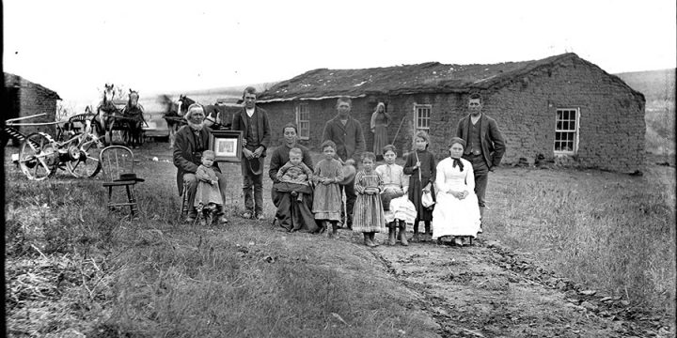
Key Developmental Changes in time
Iowa European pre-settlement
  home to several native American tribes
  tall grass prairie (75-80%) , oak savannah, forests, and wetlands
  Julian Dubuque 1788
Settlement
  1830s, focus was on the forest lands
  1846 - Mormon migration, Iowa becomes a state
  1850s – population exploded
  1900 – prairie was gone, less than 1% left, today 99.9% gone
    Land area 36 million acres, 30.5 m. farmland acres
    99 Counites – 87 rural, 12 urban
    many rural counties were at their maximum population, today are near ½ of their max. population

Slide 5
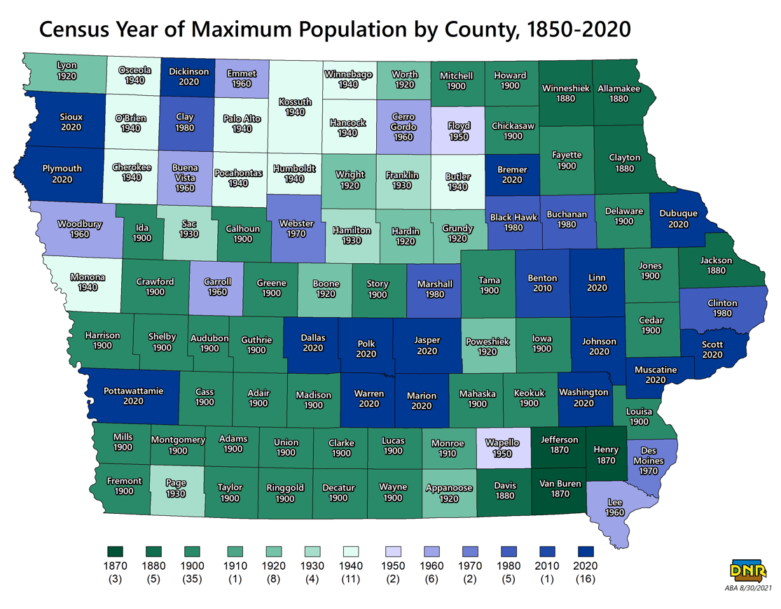

Slide 6

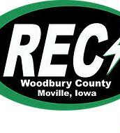
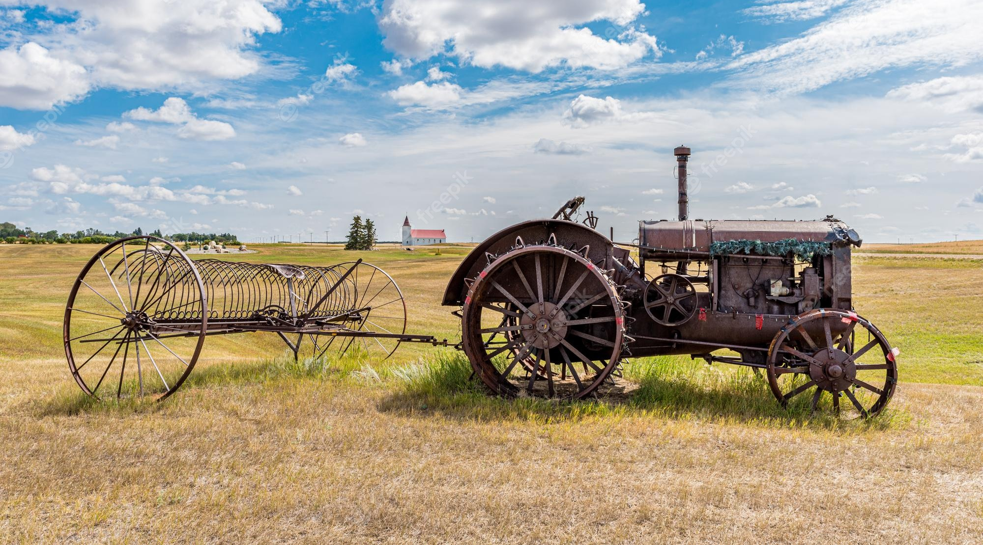
  C. 20th Century, a century of change
  Changes: All weather roads, electricity (RECs 30’s), phones, tractors, airplanes, satellites, commercial fertilizer, automobiles, pickups, soybeans (1930’s), Iowa stayed an agricultural state but with an urban population
  Technology Changes: Revolutionary or Evolutionary, affects adoption time
    Tractors were Revolutionary
      1892 1st tractor sold in IA (pully & drawbar HP)
      1933 – rubber tire option, 1945 power source, PTO, power steering, hydraulics, etc. all evolutionary
      Mid 40’s before tractors were fully adopted
    Commercial Fertilizer & Liming was Revolutionary
      Developed late 1800s, WWI & WWII, USDA C/S
  Information sources
    Dad & Grandpa
    Other Produces, in the 30s farmers organized cooperatives (RECs, telephones)
Notes:
Soybeans first used for hay.
In 1925 89% of farms were on a dirt road. By 1950 it was 21%.
In 1925 on famers had phones, 10% had a tractor and electricity. By 1950 80%+ had a tractor, electricity and phones.

Slide 7
20th Century Public Policy Impacting Conservation in IOWA
1906 - The Agricultural extension Act, early version of the Extension Service
1914 - National Coop Extension Service, created by Smith Lever Act
1933 - Soil Erosion Service (SES)
Agricultural Adjustment Act (AAA), created to subsidize farmers to reduce production
1935 - Soil Conservation Service (SCS)
1936 - Agricultural Cost Share program (ACP)
  created by Soil Conservation and Domestic Allocation Act
  replaced by EQIP in 1996
1937 - Soil Conservation Districts (SCD)
  1940 Montgomery Co. 1st in Iowa
  At that time Iowa had 213,000 farms, now 85,000. Montgomery Co. had cattle and hogs on over 80% of farms
1946 - Soil Conservation Society of America
  water added making it the SWCS, to reflect international scope & water as a major resource issue
Notes:
created by Standard Soil Conservation District Law
water added making it the SWCD
In 1940 Montgomery 91% of farms had cattle, 83% had hogs, mostly farrow to finish.

Slide 8
Conservation policy cont…
1953 Pilot Watershed Program
  created 62 projects nationally with 4 in Iowa
  demonstrated landscape scale approach to address conservation issues
1954 PL 566,
  allowed projects for Watershed Protection and Flood Prevention
  Iowa had highest number completed in the Nation
1970 National Environmental Policy Act
1973 Iowa Sediment Control Law, including State Cost Share
  Iowa Financial Incentive Program (IFIP)
  Other financial assistance added later including REAP, SRF and a variety of water quality programs.
1977 Clean Water Act
1985 1st Federal Farm Bill to have conservation in the title.
  Established conservation compliance (HEL, sodbuster, swamp buster) and CRP
1993 Emergency Wetland Reserve Program (EWP)
  as a result of Midwest flooding
  Iowa hardest hit State, 99 counties covered by a Presidential Disaster Decoration
  first time USDA offered an alternative to restoring farmland to something other than pre-damaged use

Slide 9
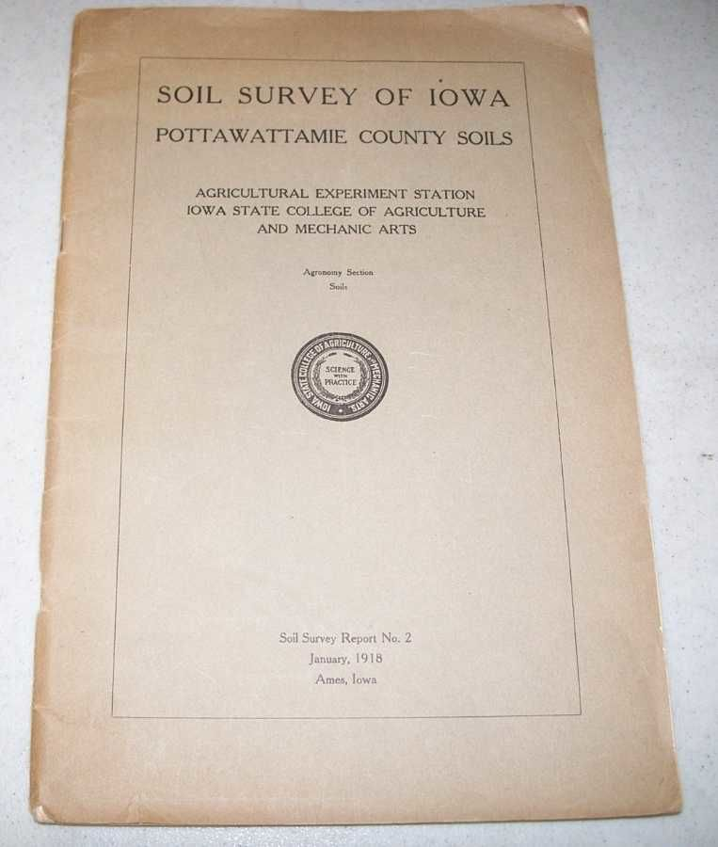
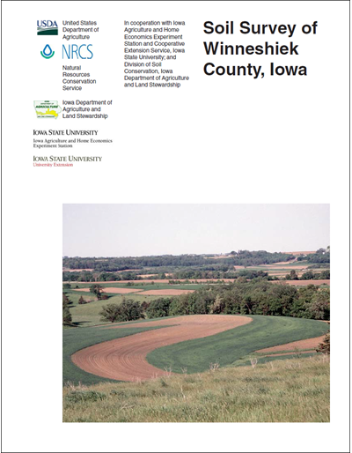
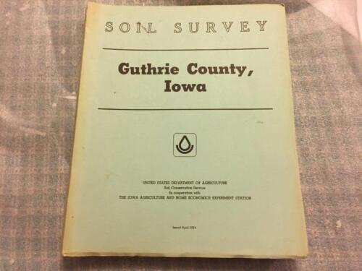
Soil Survey Work
Soils surveyed in early, mid, and late 20th century
  More and more refined
Partnership with IDALS-DSCWQ, ISU, and NRCS
Soil bulk density increasing 25%
CSRs big impact

Slide 10
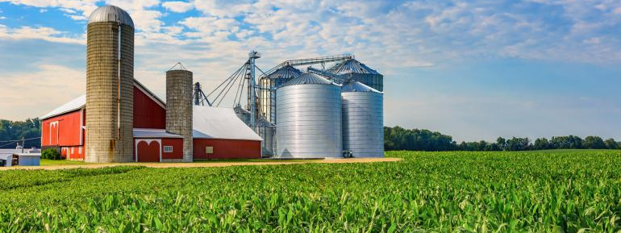
Iowa Today

Slide 11
Iowa population
1950 2021
2.6 million 3.2 million
29% of pop. lived on farms 4.5%
22% rural (not on farms) 31.5%
49% urban 64% urban
Farmers mostly owner/ operators 58% cash rent
Notes:
Iowa is an Ag State with an Urban Population

Slide 12
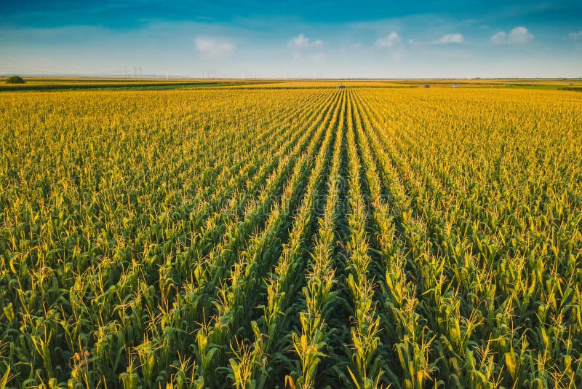
Iowa Agriculture
#1 in corn production
#2 in soybean production
#1 in swine production
#1 in chickens
#4 in cattle numbers
#7 in turkeys
Notes:
In 2022
Chris Jones, Research Engineer, University of Iowa Iowa is the #1 producer of manure in the country.

Slide 13
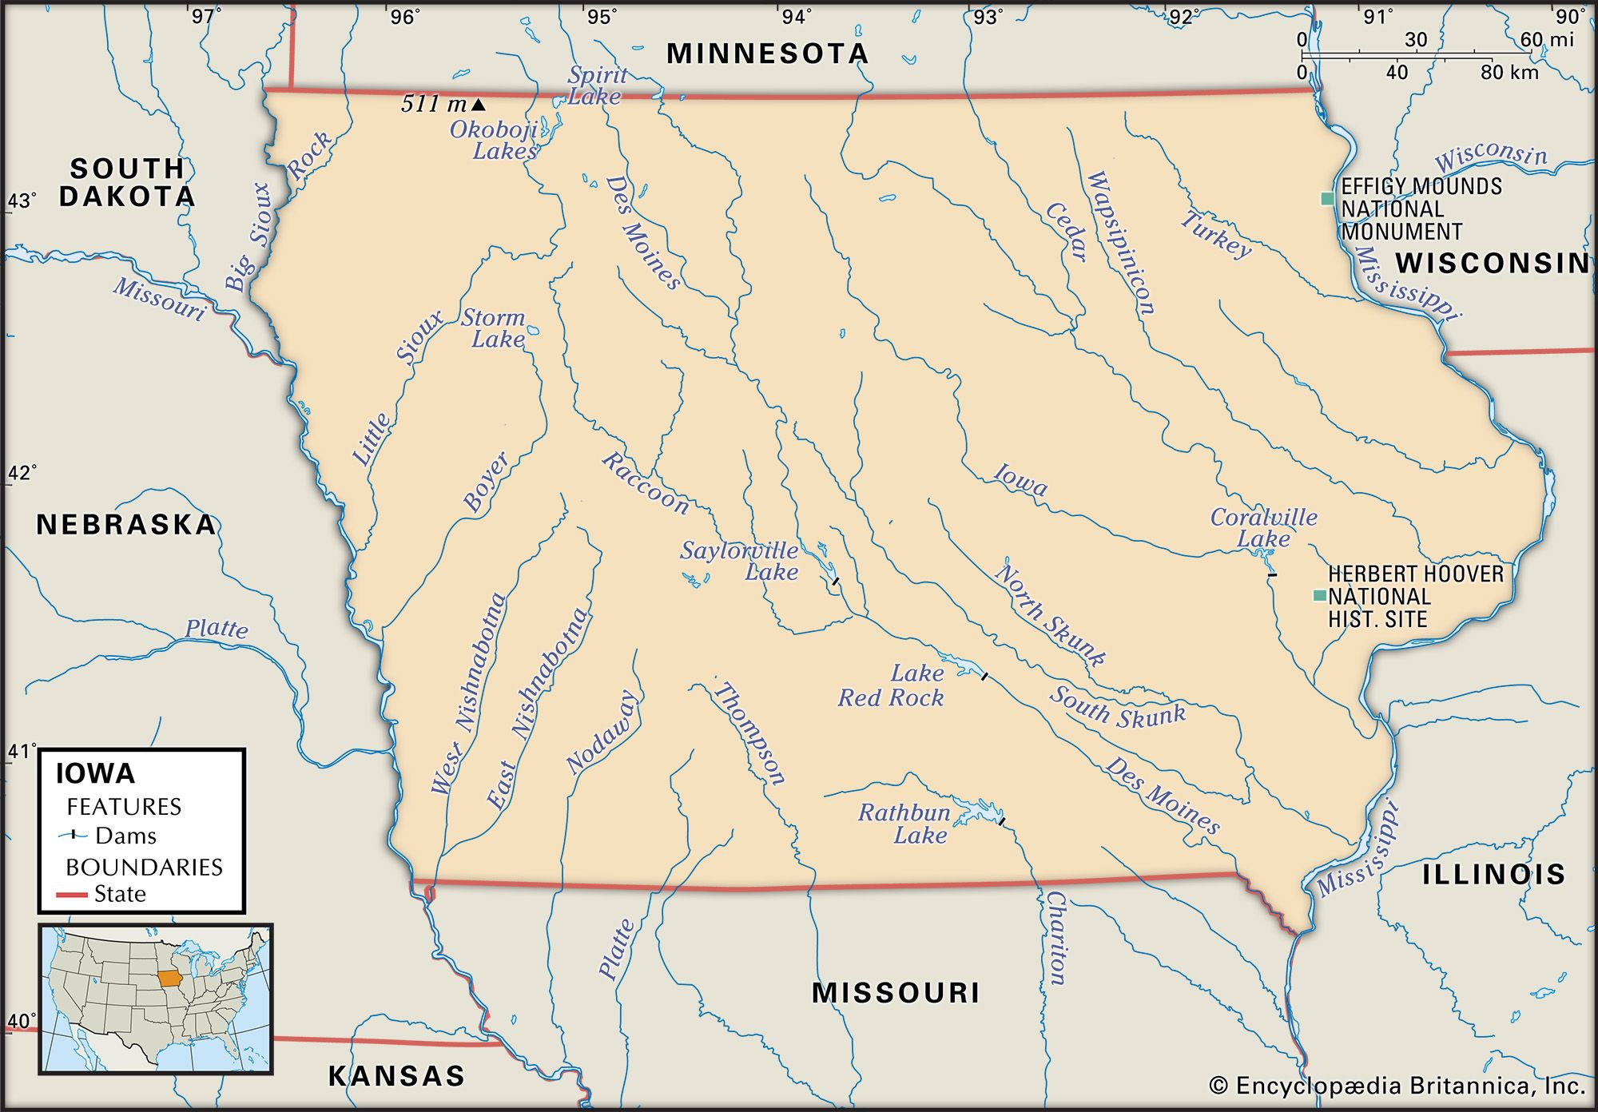
Iowa land
36 million acres
Farmland acres: 30.5 million
Cropland acres 24.5 million (68%)
  corn: 12.9 million acres, soybean: 10.1 million acres = 23 million (64%)
  CRP 1.7 million
  hay land: 1.3 million
  oats: 0.1 million
Pasture: 2.1 million

Slide 14
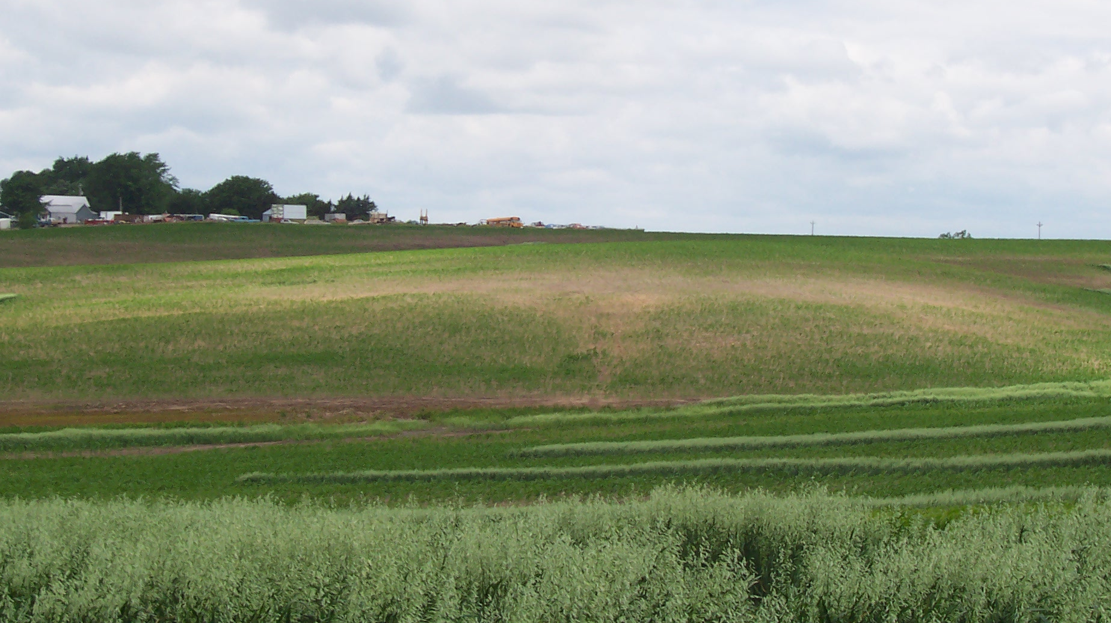
Iowa’s Top Resource Concerns
Soil erosion
Soil quality
Water quality
  Sedimentation
  Nutrient loading
  Harmful bacteria
Air – Greenhouse emissions
  i.e., Nitrous oxide, CO2
Natural ecosystems / wildlife

Slide 15
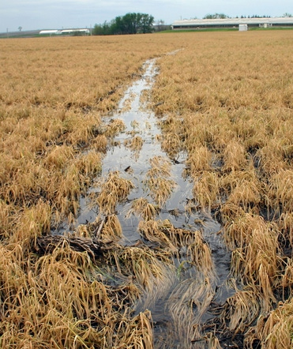
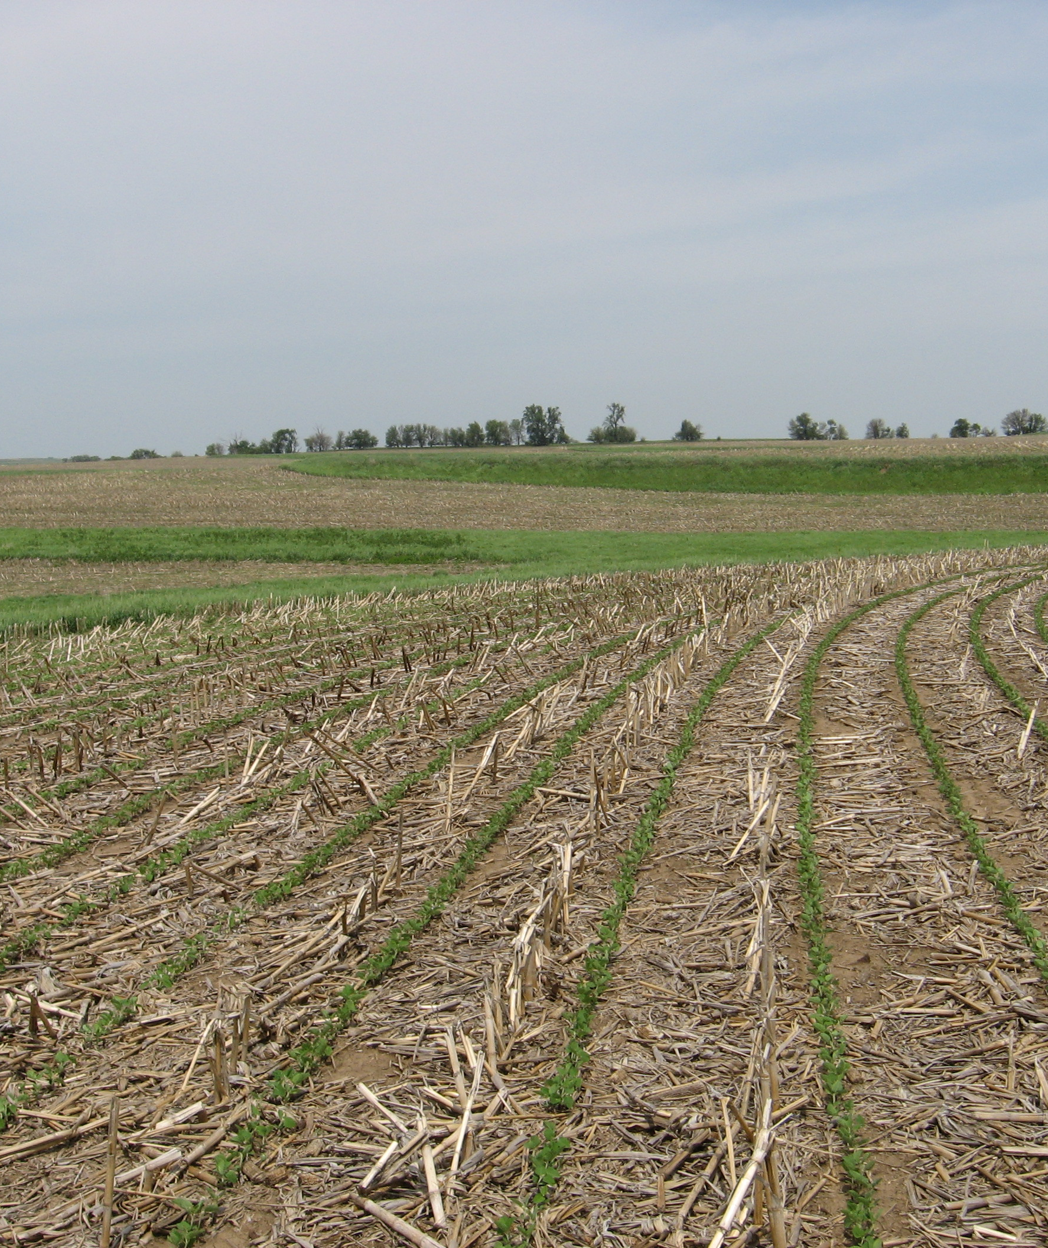
Soil Erosion
No-till / Strip-till (INREC survey)
  NT corn 32%, NT Beans 46%
  Long term NT < 25%
Cover crops
  2017 – 6.9%, 2021 – 12.1% (2.8 million acres) (INREC survey)
Terraces
  New terraces = removal of terraces??
Notes:
INREC – Iowa Nutrient Research & Educational Council Board of Directors: Iowa Farm Bureau, Agribusiness Association of Iowa, Livestock Producers, Iowa Corn, Soybean Producers, CCA, Fertilizer Retailers, Crop Production Companies, Fertilizer Manufacturers/ Wholesalers, Iowa Secretary of Ag, ISU-Dean of Ag l

Slide 16
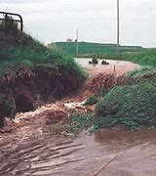
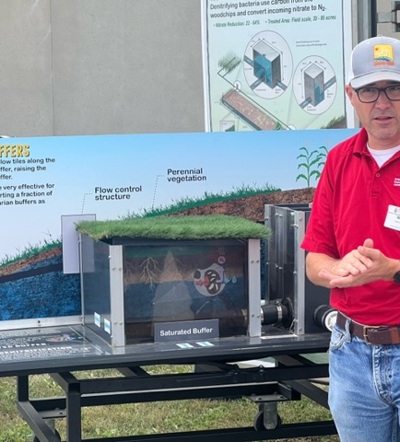
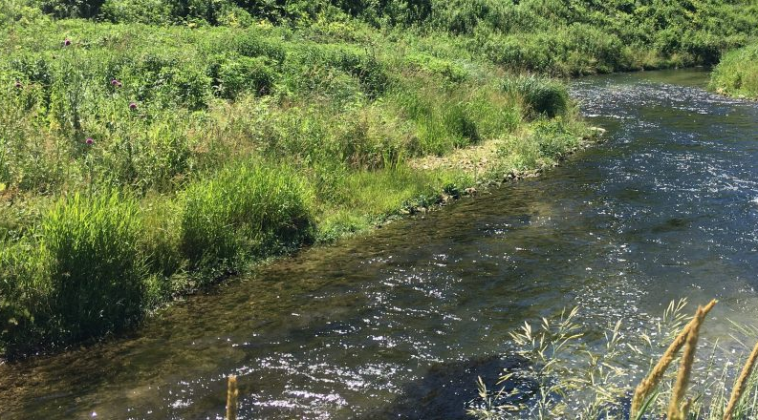
Water Quality
Sediment
Nitrogen (nitrates)
  4Rs (right rate, right placement, right product, right time)
  Cover crops
  Edge of field
    Saturated buffers, Bio-Reactors, Wetlands
  Phosphorus
  Particulate (2/3 contribution)
  Soluble (1/3 contribution)
Bacteria (fecal, cyanobacteria)

Slide 17
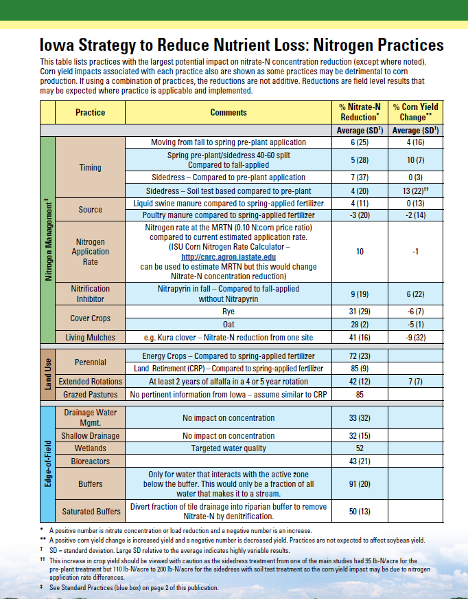
Iowa Nutrient Strategy
Adopted in 2013
Nutrient Reduction Goals
  Phosphorus – 45%, non-point 29%
  Nitrogen – 45%, non-point 41%

Slide 18
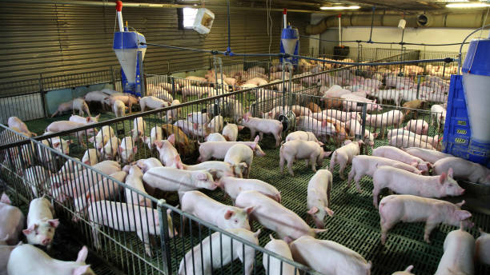
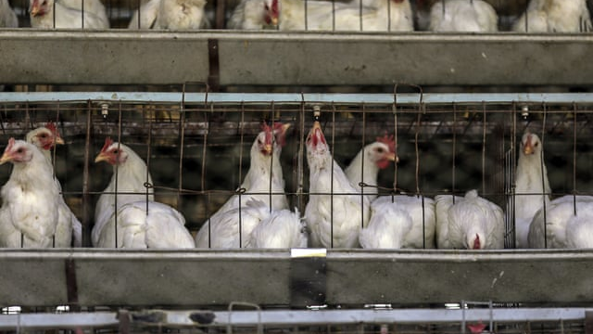
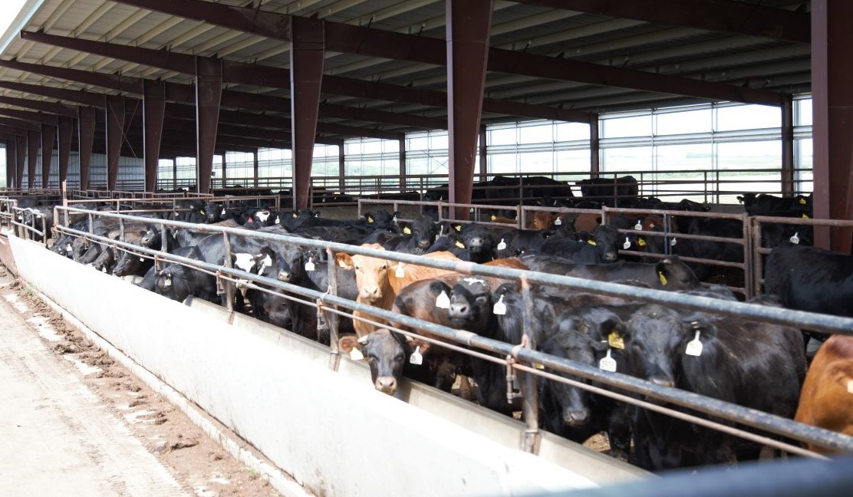
Iowa’s Livestock Industry
Swine
  #1 in inventory of hogs with 23,000,000 million head
  Hogs are owned by a company
  Facilities are operated by companies or by the producer
Cattle
  #7 in inventory of cattle & calves
  Feedlots are a mix of ownership
  Cow/ Calf operation majority of producer ownership
Poultry
  #1 in inventory of chickens with 54,765,000 head in 2022
  #1 in layers & egg production
  #7 in inventory of turkeys, with 11,900,000 in 2018
  Facilities operated & owned by businesses who don’t produce crops
Notes:
3/2022, next states are MN with 8,600,000& NC w/ 8,000,000
We have done a good job on the farmstead with point source manure
Swine – a lot of producers won the building and more or less custom feed the hogs, Integrators like Smithfield, Prestige own the hogs. Some companies like Select own the building or lease it, own the hogs, and their employees raise the hogs.

Slide 19
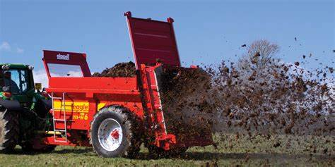
Manure – Iowa is the #1 producer
Pros
IDNR Manure Mgmt. Plans required
  Requires manure testing, soil testing, & P-Index
Improved applicators
More value put on manure
Broker manure, especially poultry and then cattle
Soil health benefits
Raising livestock where we need nutrients
Cons
Application timing
Manure adds complexity to the nutrient system
  Variability
  Availability of N
  Volatilization factors
IDNR Management Plans
Increased offsite nutrient concerns in high density livestock watersheds
Notes:
Chris Jones Univ of Iowa, retired – we have enough manure in Iowa to take care of 40% of our nutrient needs
INREC survey approximately 20% of our cropland receives manure

Slide 20
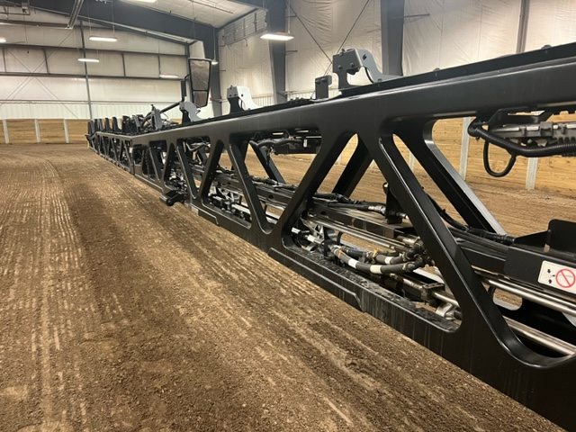
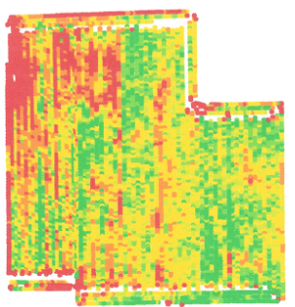
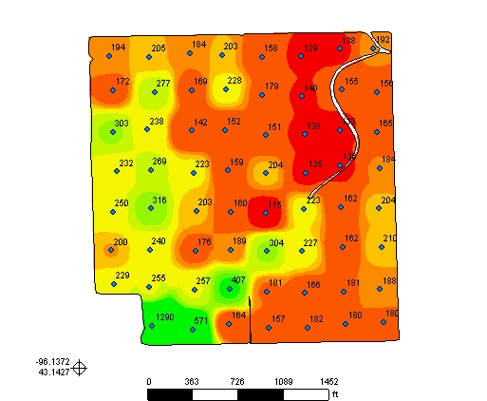
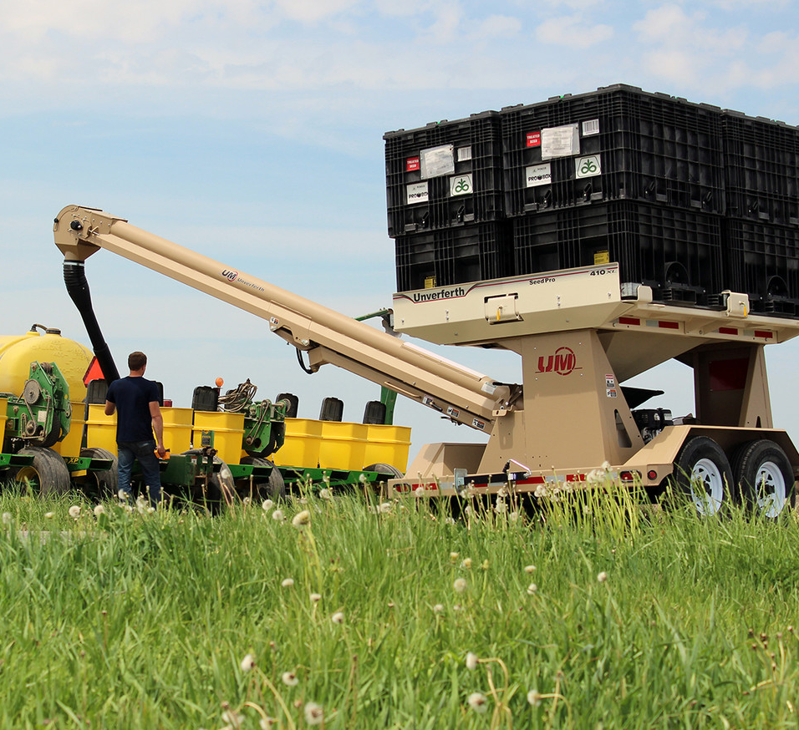
Technology
Planters
  GPS – no row markers
  Automatic row shut offs
  Autosteer tractor
  Automatic hydraulic down pressure
  Size – 24 row, 60 foot
  High Speed – 10 mph, with excellent corn singulation & spacing
  Spiked closing wheels, for no-till
  Seed, 40-unit containers
Sprayers
  Automatic shutoffs
  Weed-Recognition Technology
    12 – 25 mph
    < 25% post chemical used
    A.I
Other
  Automatous tractors, grain carts
  Lazer AI weed killers, used today for organic production
  Soil Testing, chemistry & now soil microbes
  VRT (57% for P & K)
  Yield maps
Notes:
Green Eye Technology – Green Eye, John Deere - See & Spray, Trimble - Weed Seeker 2 (Trimble)
Metagenomics sequencing

Slide 21
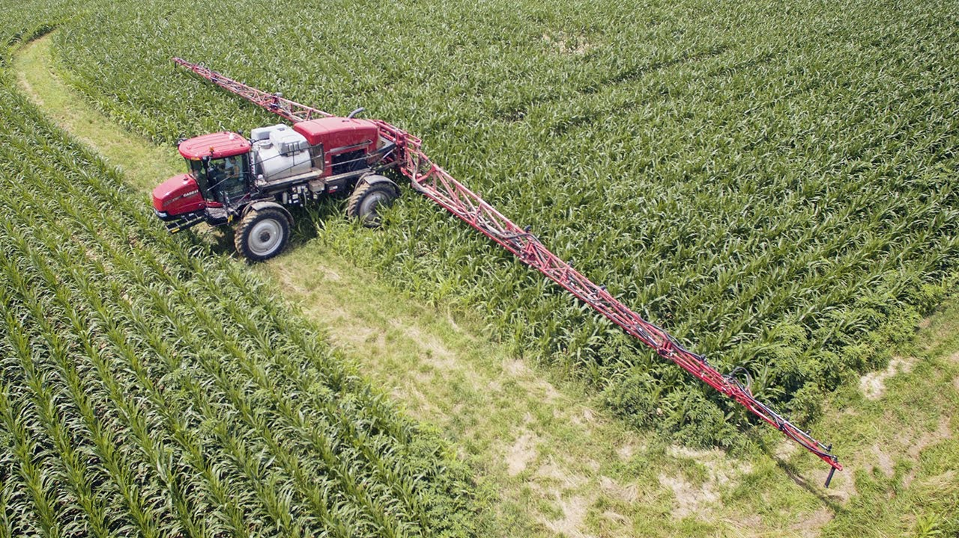
Farm size increasing
Factors affecting growth
  Technology that creates greater efficiency and requires economy of scale
  Lower input costs with greater size
  Middleman taken out for inputs
    i.e. seed sales
  On demand information
  Auctioned cash rents?
Notes:
On demand information, i.e., can look at several combine monitors & see everything the operator sees.
Autonomous Tractors coming – around the clock planting. Need to cover large acres.

Slide 22
Todays NRCS/ DSCWQ Program Dollars
Conservation Stewardship Program (CSP)
  2016 – $6.3 million
  2023 – $21.5 million, 3.4X increase
Environmental Quality Incentive Program (EQIP)
  2016 – $17.7 million
  2023 – $36.5 million, 2X increase
Easements
  Average $13 million/yr., 2,558 acres/yr.
Conservation Reserve Program (CRP)
  1.7 million acres in Iowa
Iowa Partner Dollars
  2018 – 2023: $142 million, 64 agreements
  Regional Conservation Partnership Program (RCPP) 2022 – $9.5 million
Climate Smart (National Partner Dollars)
  Climate Smart Project awarded nationally by USDA in 2023: $3.1 billion, 141 national projects
  Iowa is included on 25 of the projects totaling $1.04 billion
  IDALS DSCWQ funding
    2022 – $18.8 million
  CRP – 1.7 million acres in Iowa
Notes:
Easements Total acres in program – 1.2 million?????
Climate Smart USDA funded 141 nationally funded projects; 1,050 applications received.
Inflation Reduction Act – 75 billion over next 10 years

Slide 23
Trends
Climate – intensity of storm events increasing
Technology Changes - Less Labor
Larger farms (CEOs)
Local produce farms, small farms
Urbanite Farms
Societal expectations increasing focus on the environment, health, water quality, wildlife
Rented land increasing (53% in 2017 in 2022 58%)
For NRCS program dollars
Landowners (multiple) with no tie to the land, its business not personal
  38% of land ownership is trust and LLCs
Land use is stable – 23 million of corn & beans
Soil Health talk increasing
Carbon talk
Less people understand farms
New employees without an agricultural background

Slide 24
How do Conservation organizations move ahead?
Our funding processes must be efficient
Develop strategies for communicating with decision makers
  i.e., CEOs, multiple owners/ tract, cash rent operators, urbanite landowners, the small produce farms
We need maintain our role as “Technical Experts”
  Separate out our program/ contract specialist from our Technical Specialists
  Program development
  Educate others on the science
  Match the conservation system needed to meet the landowners objectives, resource concerns and societies
  Experts: Soil Conservation, Grazing, Agronomy, Manure, Wildlife, Soil Health
Know our resource concerns
Develop strategies for Iowa’s Resource Concerns
Stay current on latest tools developed
Maintain / improve relationships with our Conservation Partners
Areawide planning / watershed planning
Results must be measurable
  Water quality, soil erosion, flooding, land in cover crops, etc.

Slide 25
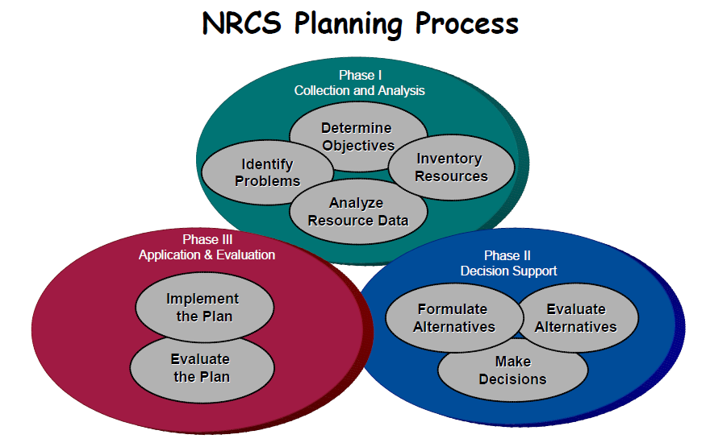
The Value of the Conservation Planner
A technical expert
Understands the resource concerns in the area & can evaluate
Can educate producers about them
Determine best practices to treat that meet the landowner’s objective
Can sell conservation
Is able to set up the producer for success when implementing practices
Understands agriculture
Has credibility with producers
Source of information
Help set up producers for success with their farms
Notes:
The conservation planner works for the landowner, resource concern, and the taxpayer.

Slide 26
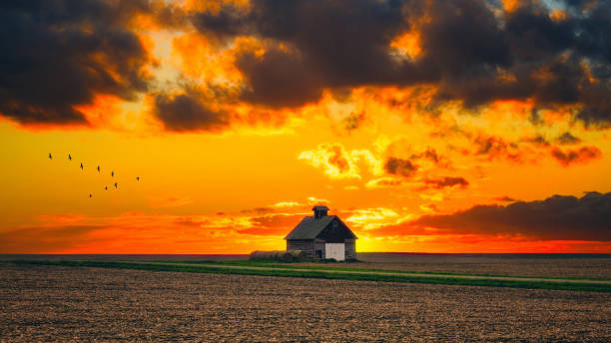
Notes:
That's our take on history and the future, let's discuss yours

Slide 27

A Conservation Planner work for
The landowner
The resource concern
The taxpayer (society)

Slide 28
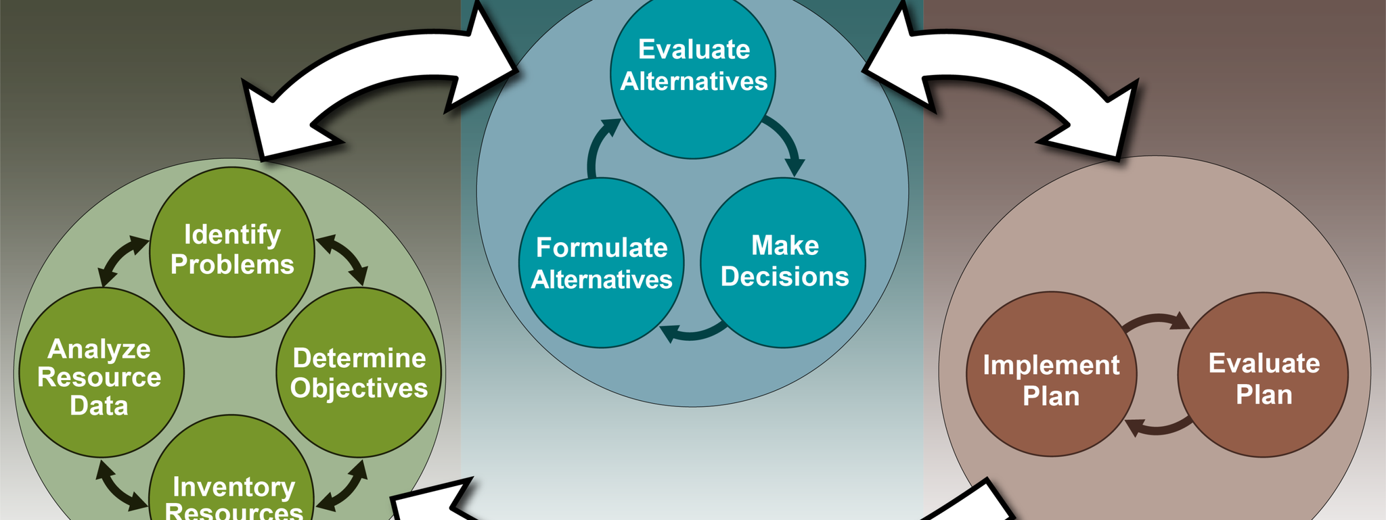
NRCS Planning Process
Notes:
The conservation planning process helps the planner and client accomplish the following:
(1) Help protect, conserve, and enhance natural resources
(2) Design alternatives that meet local resource planning criteria for identified resource issues
(3) Include human concerns for achieving sustainable agricultural systems
(4) Consider the effects of planned actions on interrelated geographical areas (i.e., looking offsite, beyond the planning unit boundary)
(5) Consider and explain the interaction between ecological communities and society
(6) Focus on ecological principles
(7) Consider the effects, risks, and interactions of planned systems and practices on the natural resources, as well as economic and social considerations
(8) Identify where indigenous stewardship methods might be needed or explored
(9) Assist with development of plans, regardless of scale, which will help achieve the client’s and society’s objectives
(10) Identify where knowledge, science, and technology need to be advanced
(11) Assist with meeting requirements for NEPA, which is incorporated into all steps and activities of the conservation planning process (see Section 600.41, “Integrating NEPA into the Planning Process,” for additional information)

Slide 29
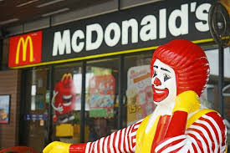
Transactional Sales
Notes:
What were not. You order the Big Mac they give it to you. They don’t look at you Body Mass Index or run a cholesterol test. And say the fish sandwich might be a better option.

Slide 30
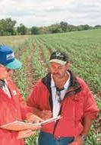
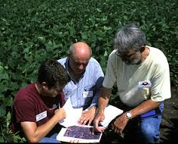
Conservation Planning
Its our way of doing business
The decision maker for the tract of land is now more difficult to determine
Landowner / Operator are emotionally tied to the land
  Renters?
  Absentee landowner ?

Slide 31
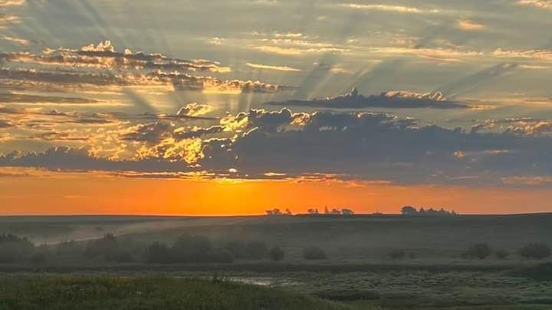

Slide 32
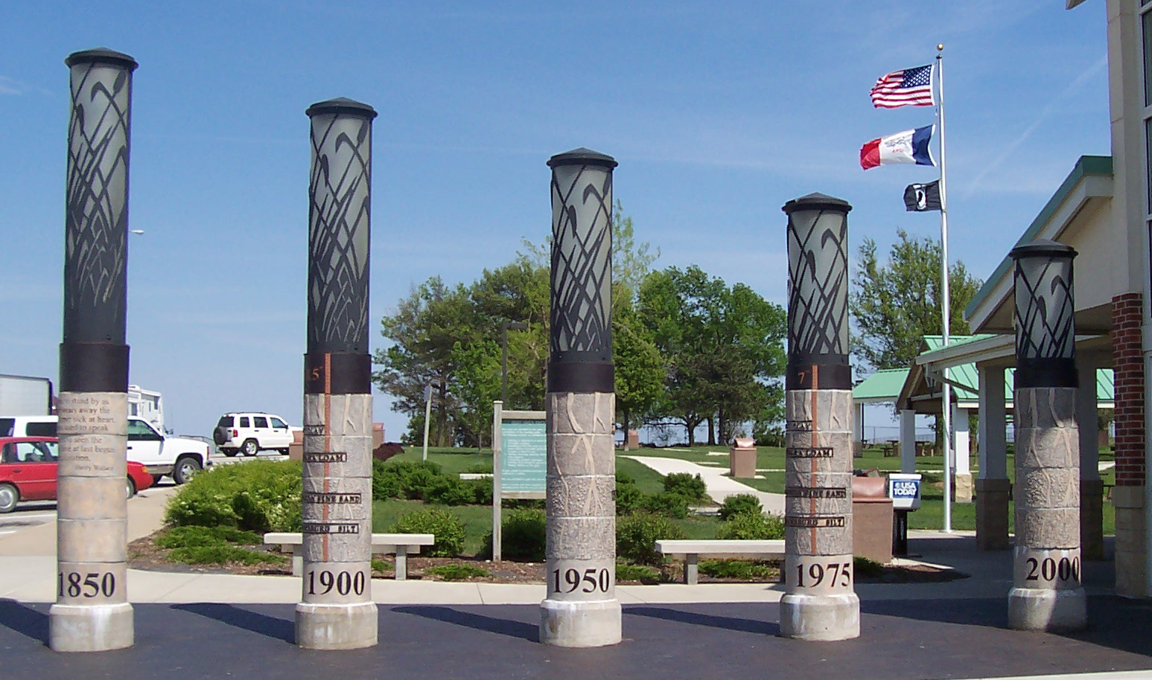
Historical Topsoil Loss in Adair Co.
14 inches
5.5 inches
1850
2000
Adair Rest Stop
Notes:
Artist Depiction of Topsoil loss in Adair County. 1850 – 14” 1900 – 11.5” 1950 – 8.5” 1975 – 7.0” 2000 – 5.5”
Interstate east bound mile marker 80
Does anyone disagree with the artist's numbers?
Hard to get definitive numbers.

Slide 33
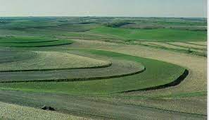
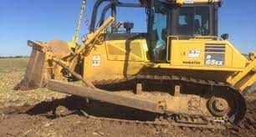
Plymouth County
90’s
  ½ to 1 million feet of terraces constructed / year
  Had 3 crews
  28 – 32 dozers running
  1997 Record Year
    1.2 million feet
    staked terraces every day from thaw to freeze up except one day
  Today
  5 dozers
  They believe there are more terraces being dozed out than being built
  More No-till, Cover Crops, and 638s
Notes:
Figures from Dennis Eppling, Plymouth County Technician
Not sure on feet built today, maybe 50,000’ but haven’t built any in the last 2 years due to dry conditions

Slide 34
Today
Cover Crops
No-till
Livestock facilities
Hoop Buildings
Pasture Management (prescribed grazing, fences, watering facilities)
Pasture & Hay plantings/ interseeding

